Slide 1
Jmeter+ InfluxDB + Grafana

Slide 2



Tools
Jmeter
Apache JMeter is a load testing tool for analyzing and measuring the performance of a variety of services.
Grafana
is a visualization and analytics software. It allows you to query, visualize, and explore your metrics no matter where they are stored. In plain English, it provides you with tools to turn your time-series database (TSDB) data into beautiful graphs and visualizations
InfluxDB
is a time series database (TSDB) developed by InfluxData. It is written in Go and optimized for fast, high-availability storage and retrieval of time series data in fields such as operations monitoring, application metrics, Internet of Things sensor data, and real-time analytics.
<number>
Notes:
<number>

Slide 3
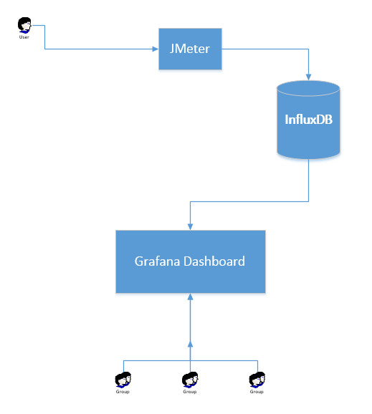
Intergration
Write you Test scripts on Jmeter
Download Influx DB and intergrate with jmeter
Using influxDB backendlistener
Create jmeter database on influx where
your test result will be saved
Download Grafana and configure you Data sources
Create dashboard on Grafana and run your test script
Navigate to Grafana dashboard and view live results from your tests
<number>
Notes:
<number>

Slide 4
Server Performance
In addition we can get other information (like server performance stats) as well into InfluxDB, then we use Grafana dashboard to check all the metrics using
Collectd - a Unix daemon that collects, transfers and stores performance data of computers and network equipment.
<number>
Notes:
<number>

Slide 5
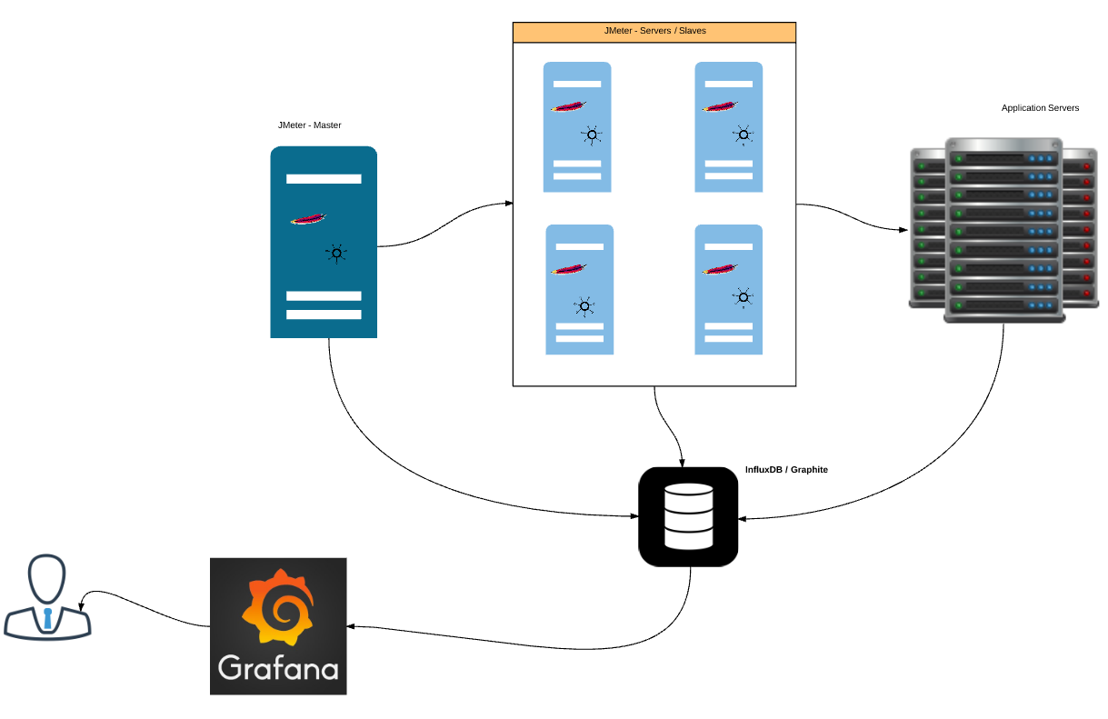
Server Performance Intergration
Enable the collectd section in influx conf file
Restart influxdb
Install & configure collectd by enabling the network plugin and specifying the server and port
Restart collectd
You should be able to see measurements specified on collectd
You can now query performance metrics from grafana and display results in graph
<number>
Notes:
<number>

Slide 6
Thank you
Notes:
<number>

